Slide 1
Session #4: GPT models
Thursday, Sept 8
CSCI 601.771: Self-supervised Statistical Models

Slide 2
Motivation
Previous work pre-trained models have been directly fine-tuned
Limitation: despite task-agnostic architecture, need task-specific datasets and fine-tuning
Issues
Large datasets needed for every new task constrains applicability
Generalization in the above setting can be poor
Humans can generally perform a new language task from only a few examples or from simple instructions – something which current NLP systems still largely struggle to do
As a result, we would want a universal model trained for diverse skills which might contain many parameters to adapt to different tasks.
GPT-3, an autoregressive language model with 175 billion parameters, 10x more than any previous non-sparse language model.

Slide 3
Problem Definition
Humans do not require large supervised datasets to learn most language tasks
Goals:
To be broadly useful, we would someday like our NLP systems to have the same fluidity and generality as humans to adapt to many skills quickly.
Meta-learning models develop broad skills at training time and can rapidly adapt at inference time. BUT inferior performance
Let’s use the parameter capacity of transformers to do in-context learning and maybe the performance will improve

Slide 4
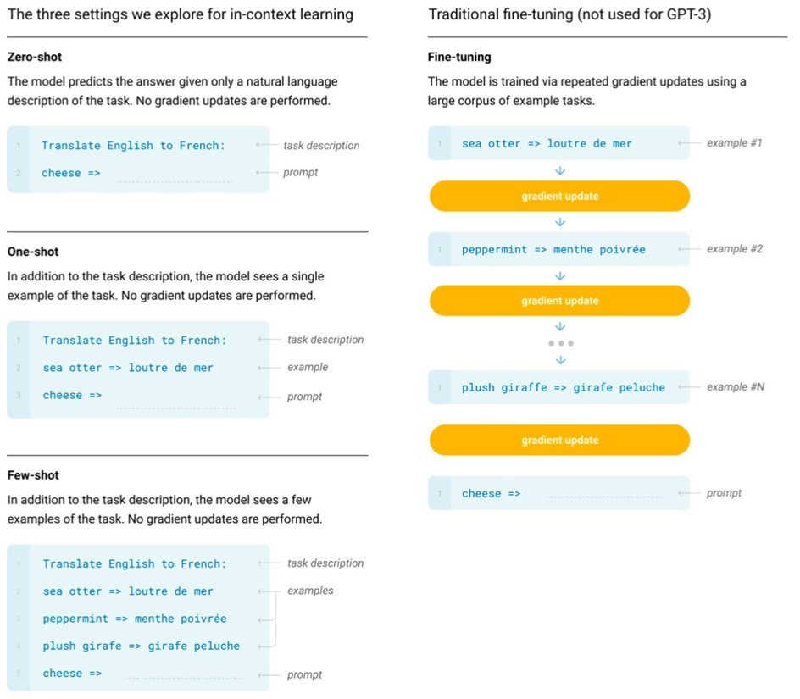
Method
These settings can be seen as lying on a spectrum of how much task-specific data they tend to rely on. Specifically, we can identify at least four points on this spectrum
The model is conditioned on a natural language instruction and/or a few demonstrations of the task and is then expected to complete further instances of the task simply by predicting what comes next.
Train a 175 billion parameter autoregressive language model, which we call GPT-3, and measure its in-context learning abilities.

Slide 5
Method
Specifically, we evaluate GPT-3 on over two dozen NLP datasets, as well as several novel tasks designed to test rapid adaptation to tasks unlikely to be directly contained in the training set. For each task, we evaluate GPT-3 under 3 conditions:
(a) “few-shot learning”, or in-context learning where we allow as many demonstrations as will fit into the model’s context window (typically 10 to 100),
(b) “one-shot learning”, where we allow only one demonstration, and
(c) “zero-shot” learning, where no demonstrations are allowed and only an instruction in natural language is given to the model. GPT-3 could also in principle be evaluated in the traditional fine-tuning setting, but we leave this to future work.

Slide 6
Method – Additional Studies
Systematic study of “data contamination” – a growing problem when training high capacity models on datasets that can potentially include content from test datasets
Train series of smaller models (ranging from 125 million parameters to 13 billion parameters) in order to compare their performance to GPT-3 in the zero, one and few-shot settings.
Discuss concerns about bias, fairness, and broader societal impacts with regards to GPT-3.

Slide 7
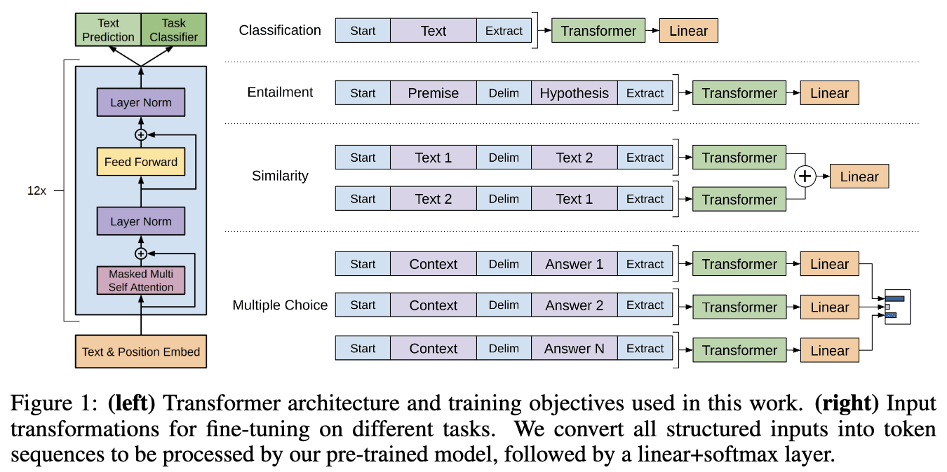
Method - Details

Slide 8
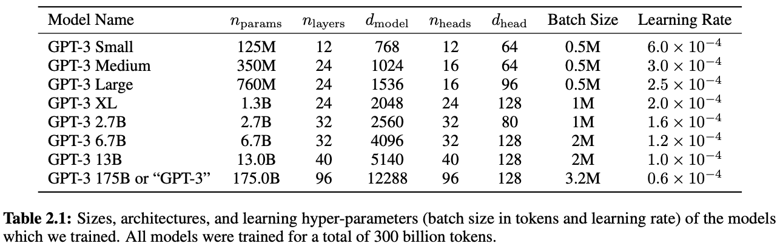
Method - Details
GPT-2
Layer normalization moved to input of sub-block
Layer normalization added after last self-attention block
Modified initialization
Scale weights of residual layers at initialization by 1/sqrt(N) (N residual layers)
GPT-3
Use alternating dense and locally banded sparse attention patterns

Slide 9
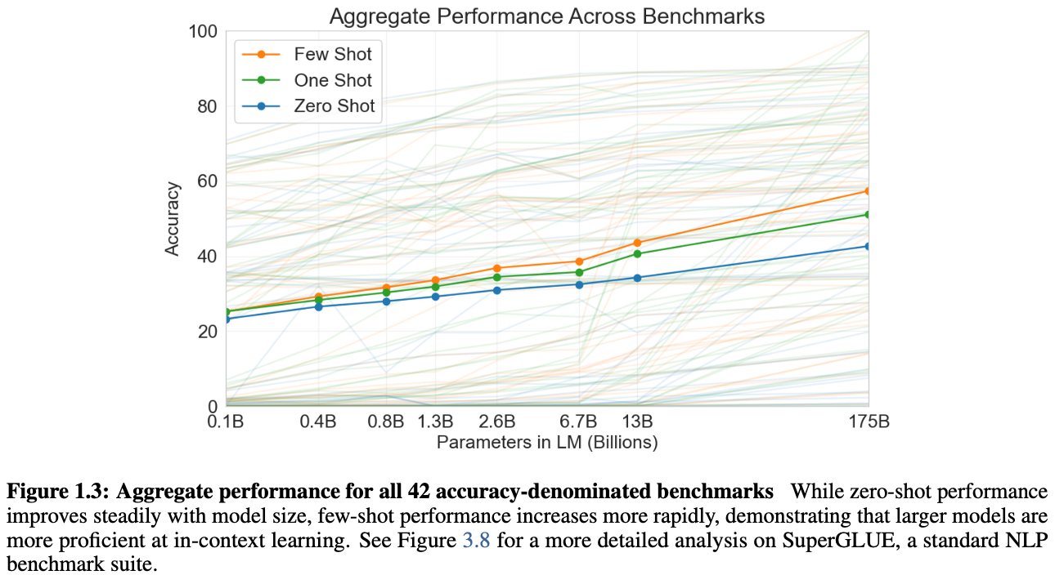
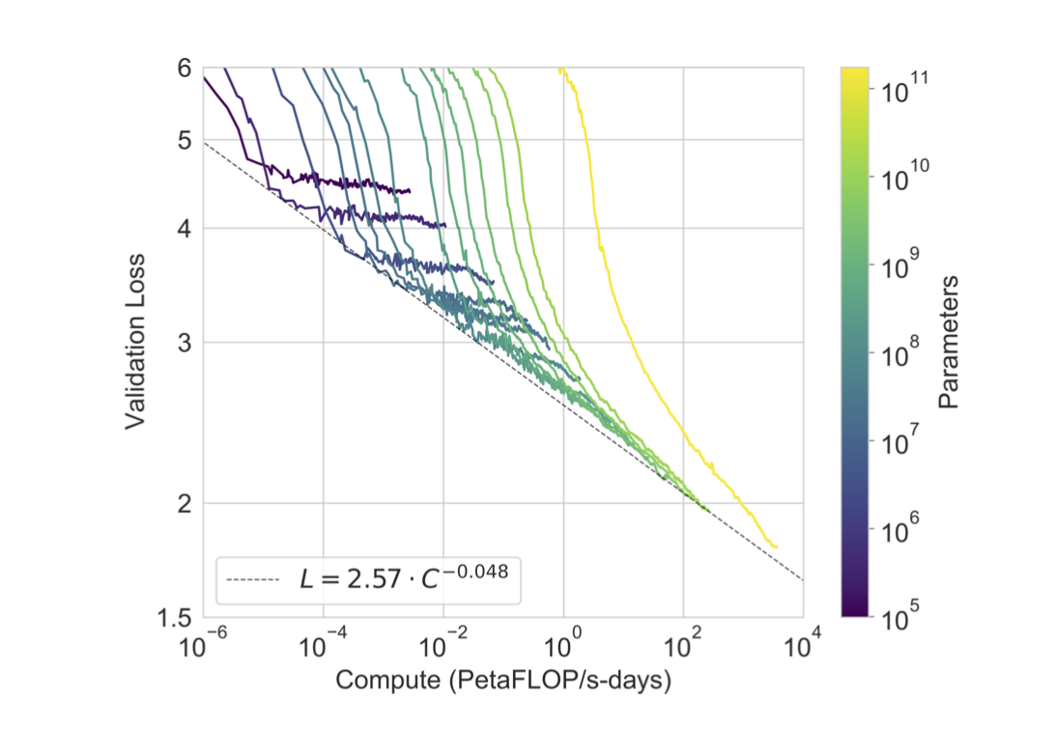
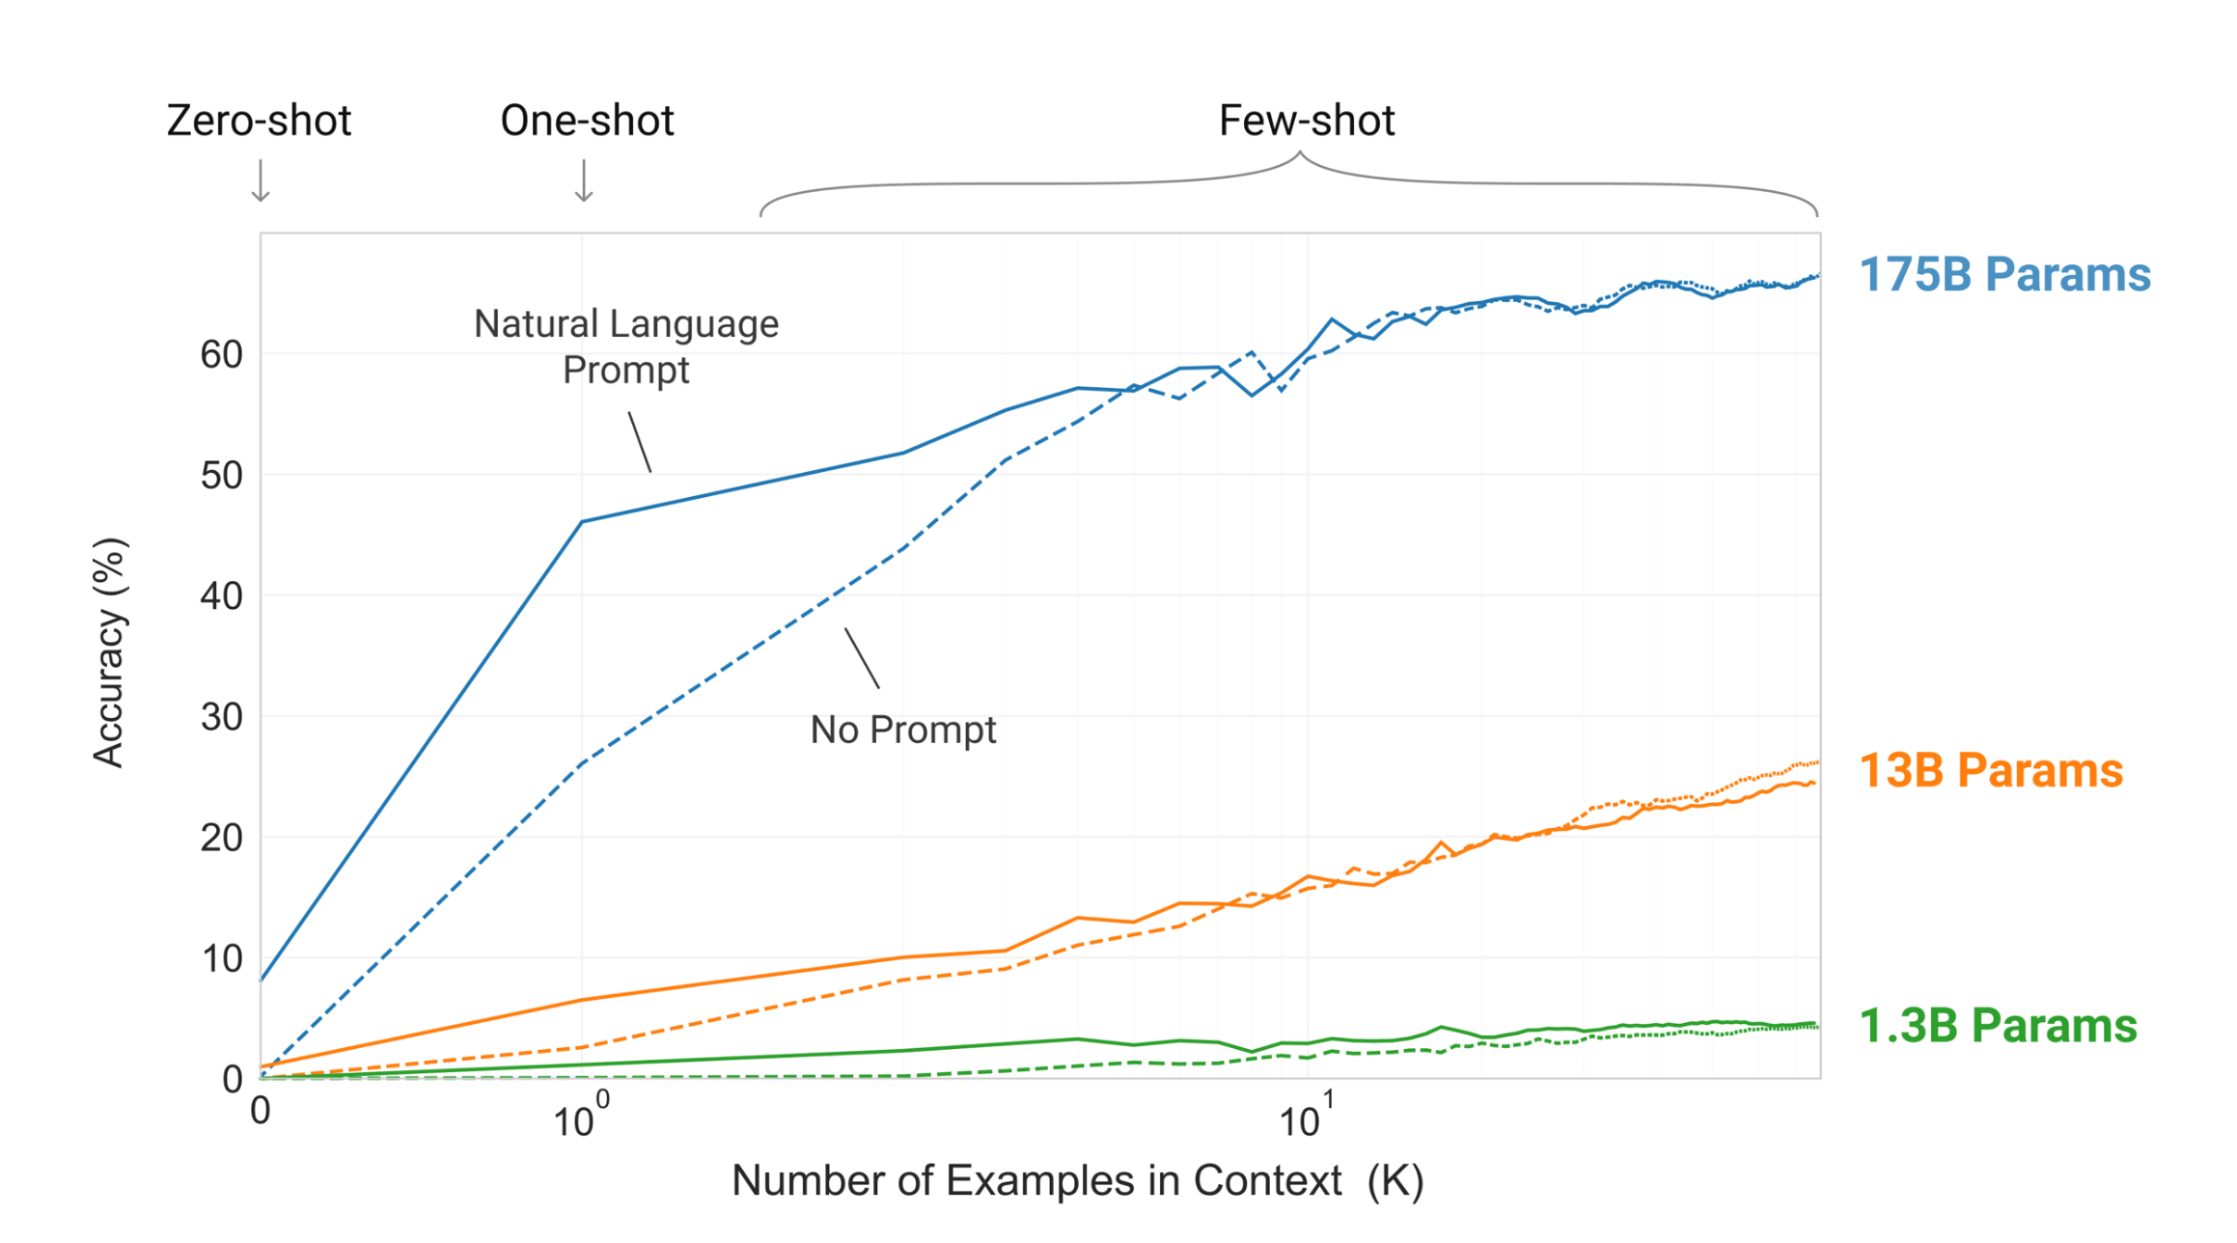
Experimental Findings

Slide 10
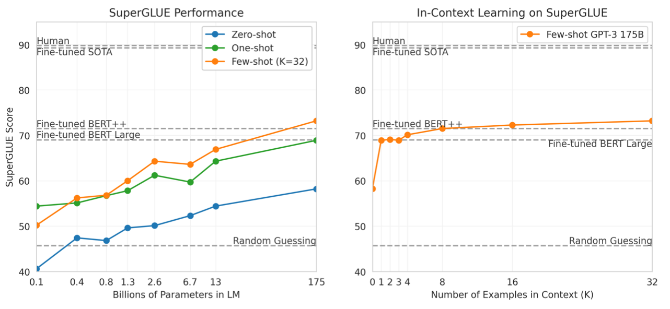
Experimental Findings

Slide 11
Review of GPT-3
1. Summary
2. Strengths
3. Weaknesses
4. Reproducibility
🔎: Neha, Steven
Notes:
steven

Slide 12
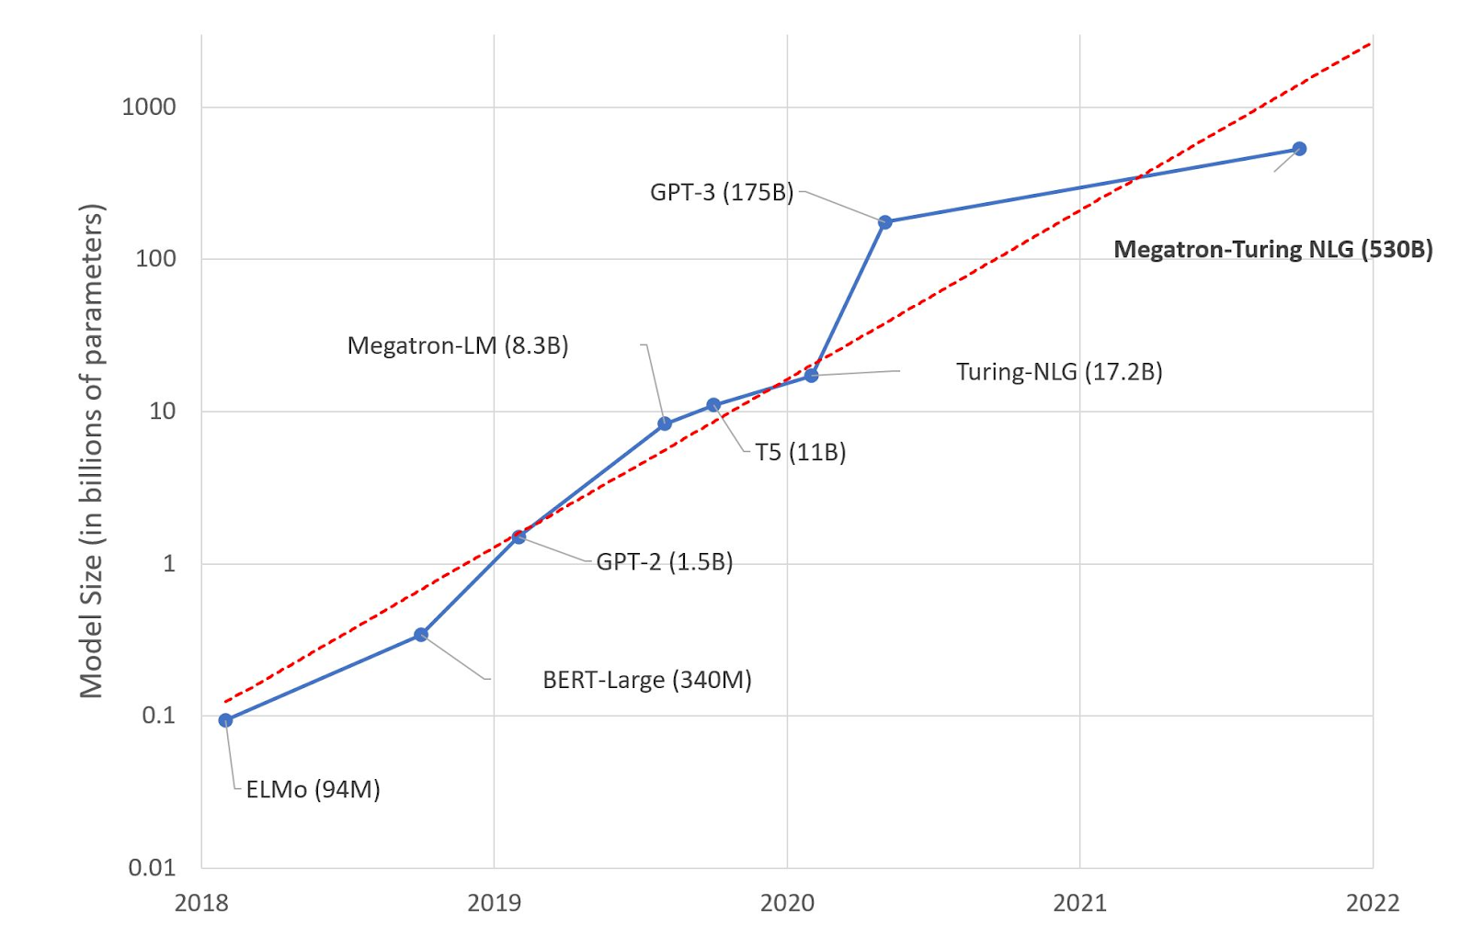
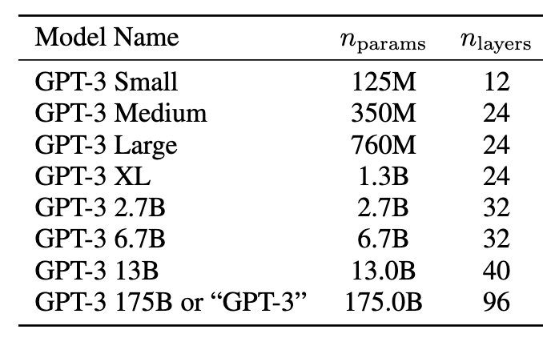
Summary
Autoregressive language model with the largest amount of parameters at its time
Demonstrated promising results of few-shot learning in multiple tasks
🔎: Neha, Steven
Notes:
steven

Slide 13
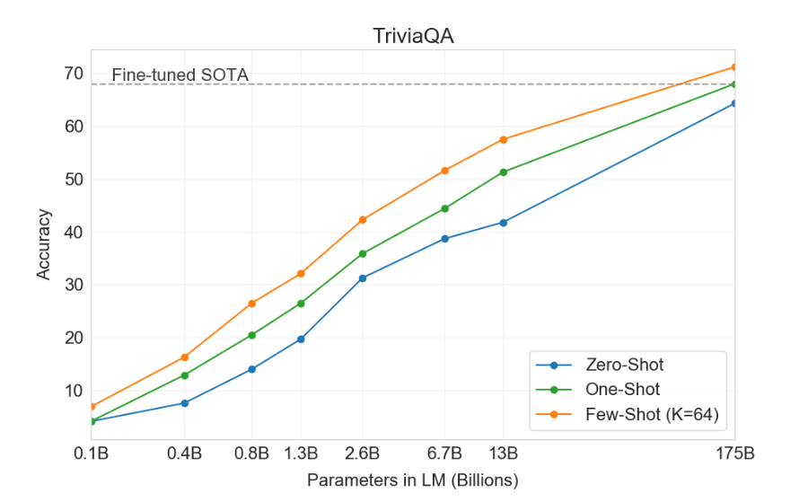
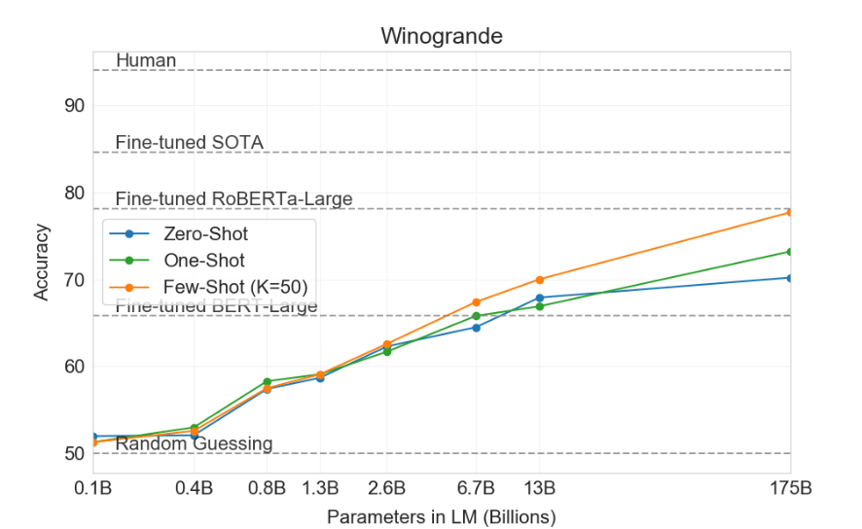
Strengths
Created paradigm shift for using pre-trained languages models
{zero/one/few}-shots versus fine-tuning
🔎: Neha, Steven
Notes:
steven

Slide 14
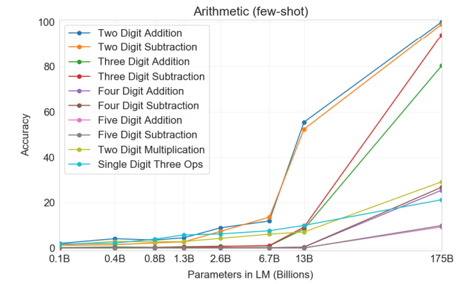
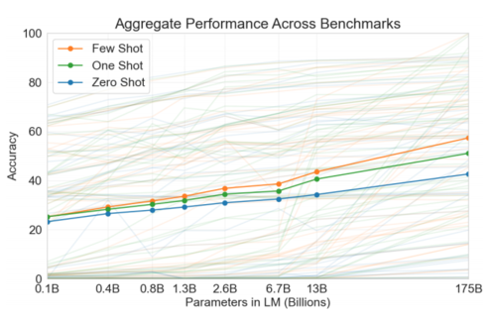
Strengths
Some tasks see large improvement due to size
(Prelude to "emergent properties")
🔎: Neha, Steven
Notes:
neha

Slide 15
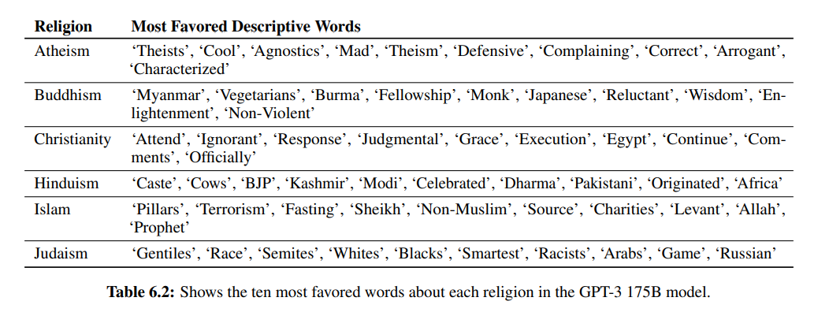
Strengths
Thorough discussion of broader impact (bias, fairness, energy consumption, etc.) and limitations
🔎: Neha, Steven
Notes:
neha

Slide 16
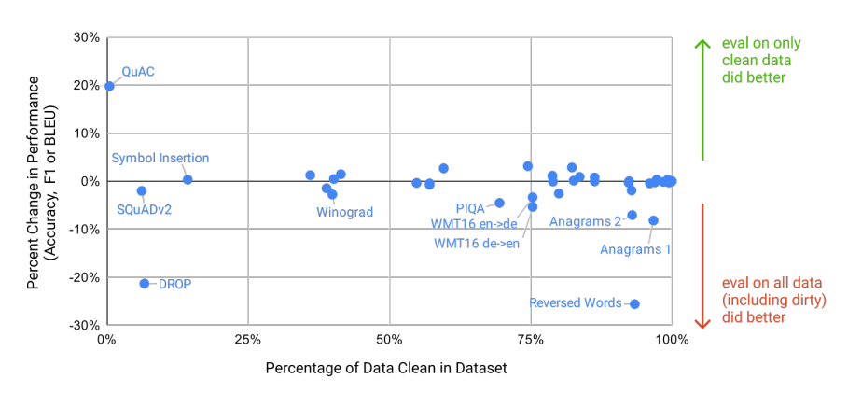
Weaknesses: Filtering
1. Bug in filtering code—contamination of training data with test/dev data
🔎: Neha, Steven
Notes:
neha

Slide 17
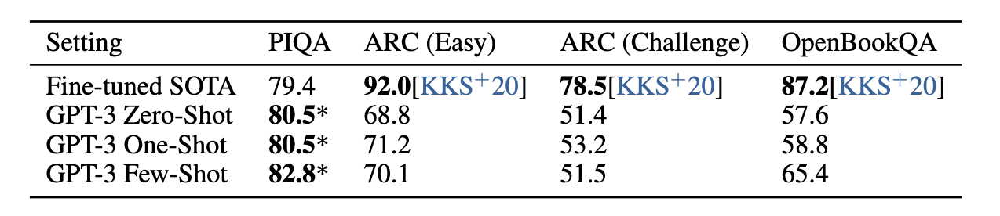
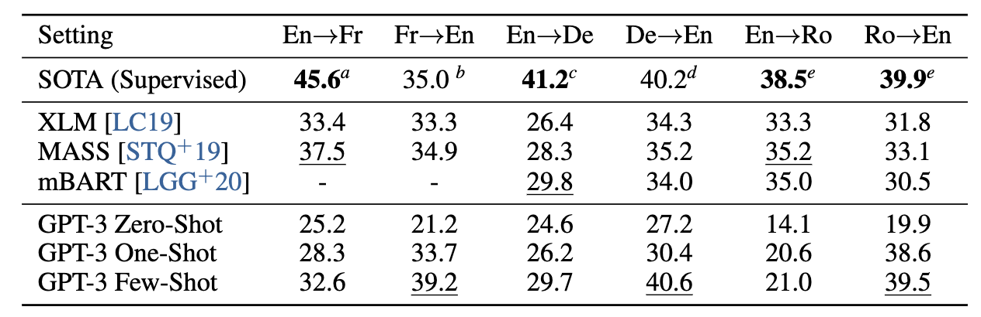
Weaknesses: In-context learning shortcomings
Lack of theoretical analysis of in-context learning
Have models seen this context?
Are they generalizing?
Improvement from in-context learning is not always consistent
🔎: Neha, Steven
Notes:
steven

Slide 18
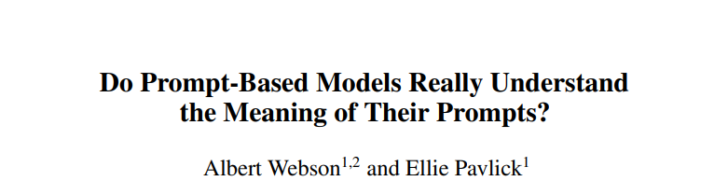
Weaknesses: Context Sensitivity
Sensitivity of model to different contexts
Prompt tuning
🔎: Neha, Steven
Notes:
neha

Slide 19
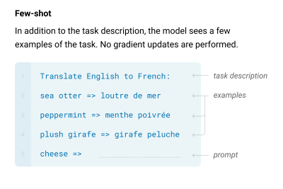
Weaknesses: Context Window
Context size is capped at 2048 tokens
What about in-context learning on long-form or document level tasks?
Some tasks may be better suited for fine-tuning due to context limit.
🔎: Neha, Steven
Notes:
neha

Slide 20
Reproducibility
Not open sourced
OPT paper (Zhang et al.)^{[1]}
No recommendations for updating model with new info
Example: COVID-19 pandemic
[1] OPT: Open Pre-trained Transformer Language Models
🔎: Neha, Steven
Notes:
steven

Slide 21
Experiments & Demo
Format: Instruction + Query
Question Answering: Instruction + Question + A:(Answer Prompt)
Models possess commonsense knowledge and can remember some facts
Translation: Instruction + text in source language
Sentiment Classification: Instruction + Sentence + Tweet sentiment ratings:(Answer Prompt)
Demo: https://colab.research.google.com/drive/16WRWYYoulZrR0FLQqjoRNoxL7frtBZ1c?usp=sharing
Playground. https://beta.openai.com/playground
Etc. https://beta.openai.com/examples
👩🏽‍🔬: Boyuan Zheng and Vicky Zeng
Notes:
https://beta.openai.com/playground

Slide 22
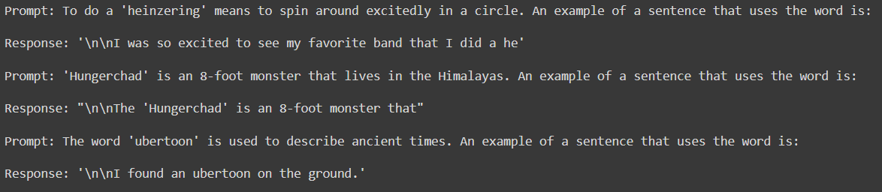
Experiments - Utilizing newly-defined, novel words
Ability to learn and utilize novel words (using a word in a sentence after given definition)
One-shot (sees one demonstration at inference time)
Prompt | Response (An example of a sentence that uses the word is: ..)
If zero-shot (no demonstration)
👩🏽‍🔬: Boyuan Zheng and Vicky Zeng

Slide 23
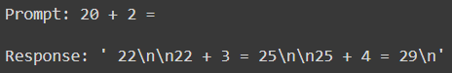
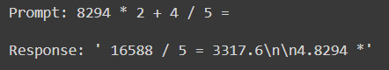
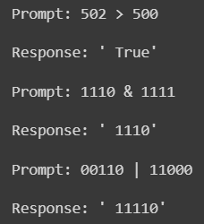
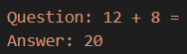
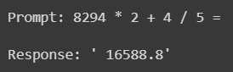
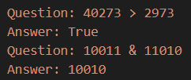
Experiments - Arithmetic and logical operations
Arithmetic expressed in natural language and pure numbers
+ - * / > < & | operators
Accuracy close to paper reports (~100% for <= 3 digits, > 25% for 4 digits)
Zero-shot (signs of arithmetic operation but incorrect)
One-shot (works for + - * / but not > < & | )
Few-shot (works for all operators)
👩🏽‍🔬: Boyuan Zheng and Vicky Zeng

Slide 24
Limitations
Probing its range of abilities (unusual tasks unlikely to be seen during training):
Optimistic performance for one-shot and few-shot setting
Beyond pure language: Other forms of reasoning (i.e. arithmetic)
Reliable performance on <= 3 digits
instances of miscarried “1”s - evidence of reasoning
25+% accuracy of 4 digits - limited generalization
Novel instances in language (i.e. newly defined words)
Evidence of understanding and usage
Attempt at conjugation and tense - limited
👩🏽‍🔬: Boyuan Zheng and Vicky Zeng

Slide 25
Before GPT3
Limitation:
1. Need for a large dataset of labeled examples for every new task.
2. The generalization achieved under this can be poor. Training data vs Fine-tuning data.
3. Humans do not require large supervised dataset to learn most language tasks
Solution:
Meta-learning :
Developing skills and pattern recognition abilities at training time.
Performance not good
Increasing the capacity of the model:
Log loss improved with scale.
In-context learning absorbing skills and tasks within parameters
Learning ability improved
🏺: Aowei Ding and Lingfeng Shen

Slide 26
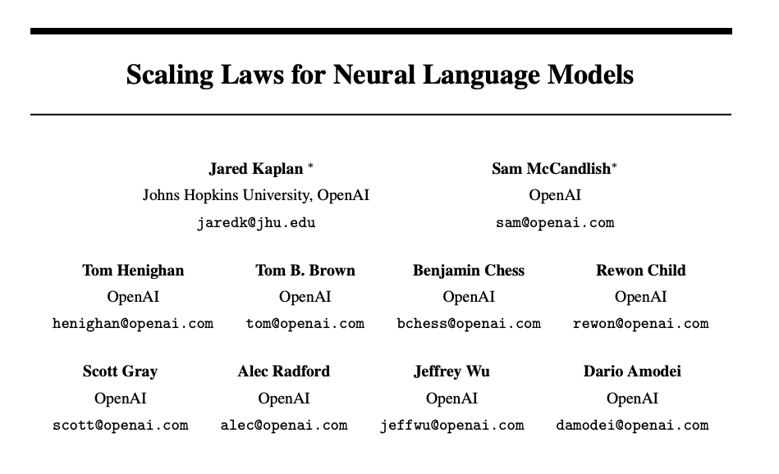
🏺: Aowei Ding and Lingfeng Shen

Slide 27
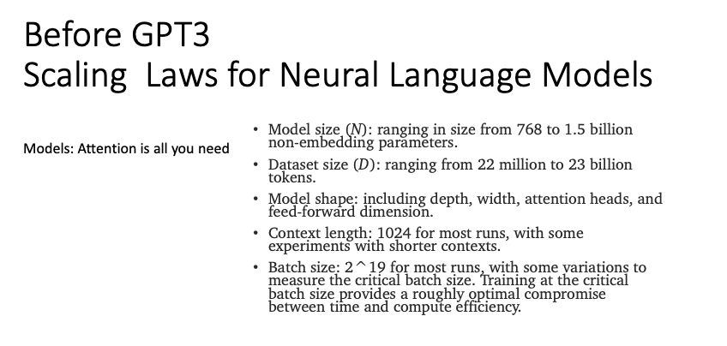
🏺: Aowei Ding and Lingfeng Shen

Slide 28
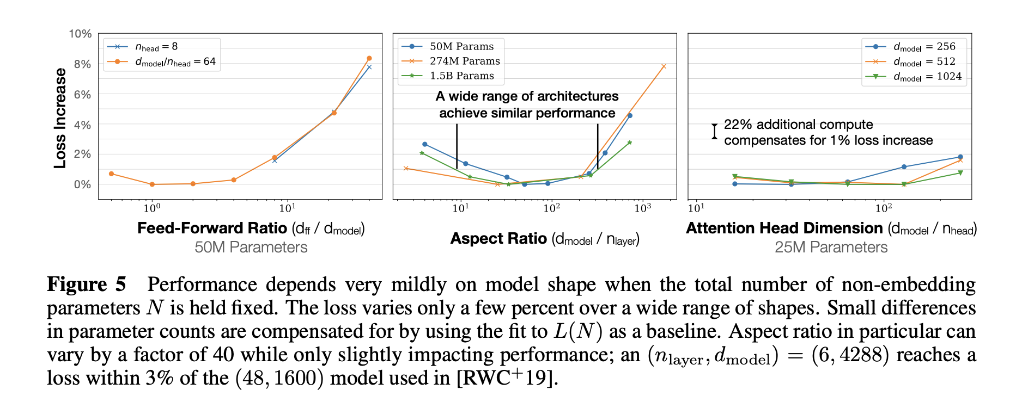
Weakly Depend on models shape
N ≈ 12n_{layer}d²_{model}
🏺: Aowei Ding and Lingfeng Shen

Slide 29
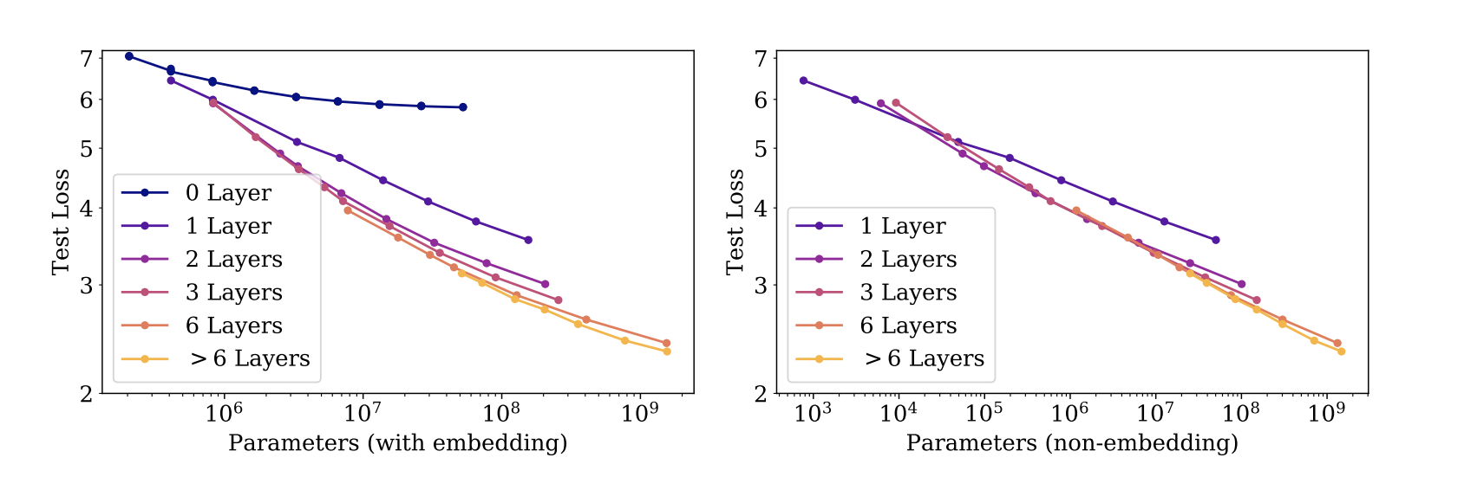
Embedding and non-embedding parameters
🏺: Aowei Ding and Lingfeng Shen

Slide 30
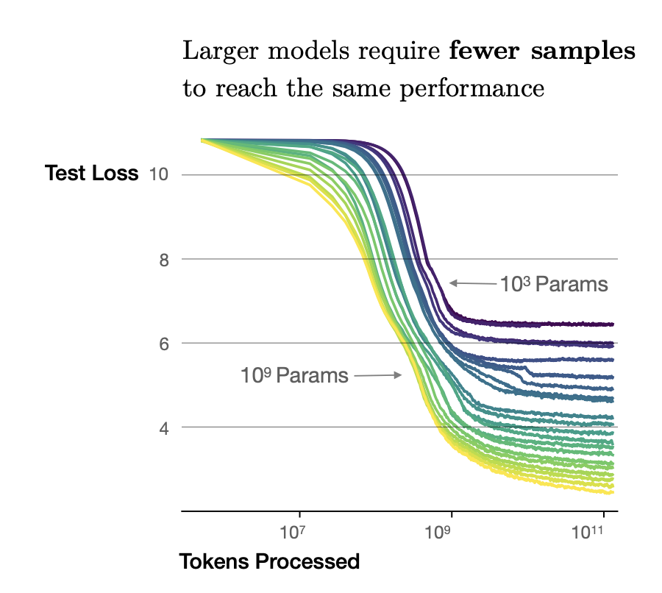
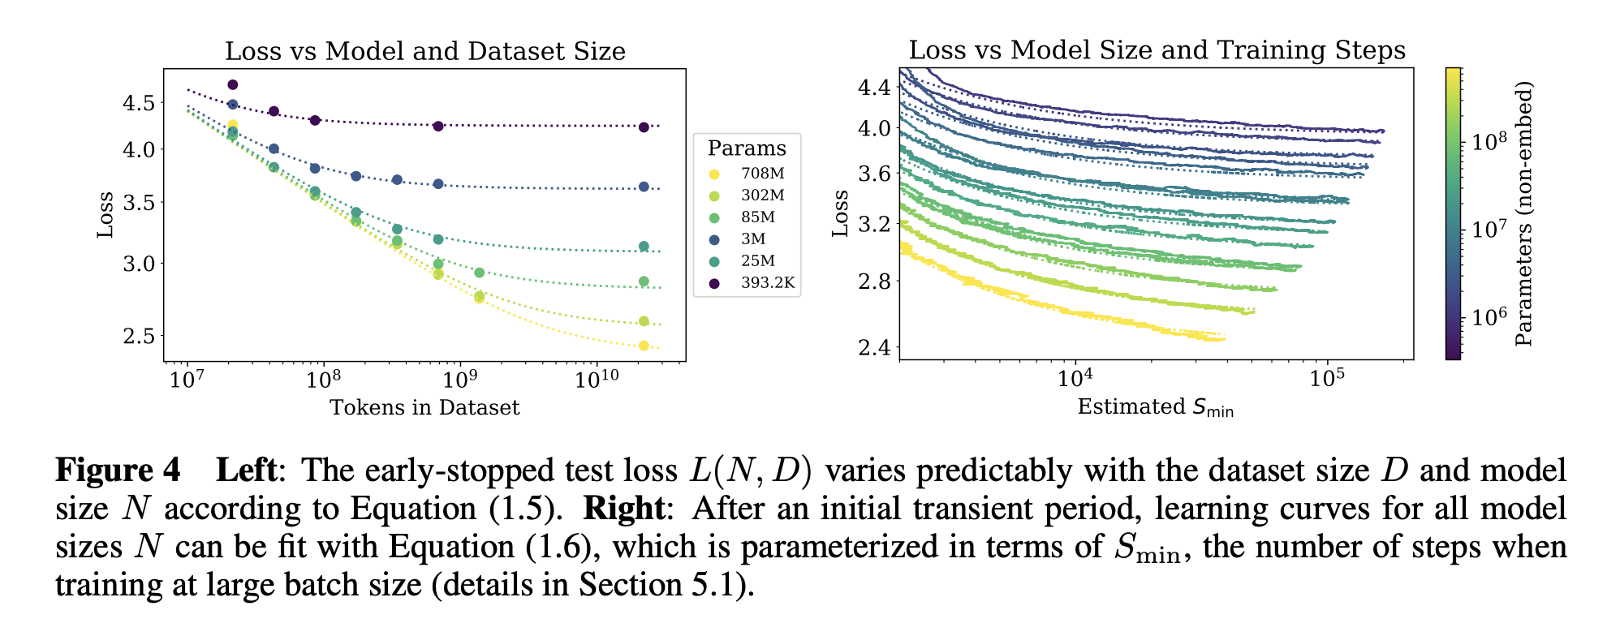
Sample-efficient
🏺: Aowei Ding and Lingfeng Shen

Slide 31
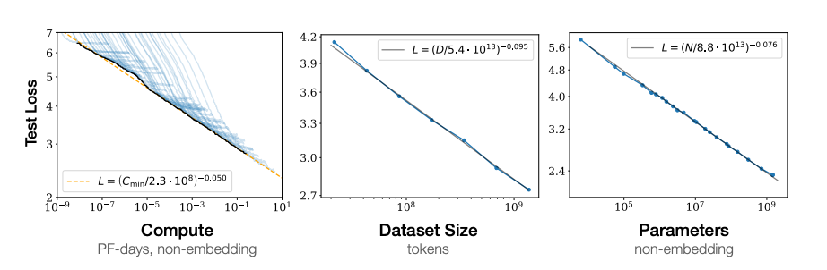
Model Size (N), Data Size(D), Compute(C)
🏺: Aowei Ding and Lingfeng Shen

Slide 32
After GPT3
• What's the general figure about GPT3?
🏺: Aowei Ding and Lingfeng Shen

Slide 33
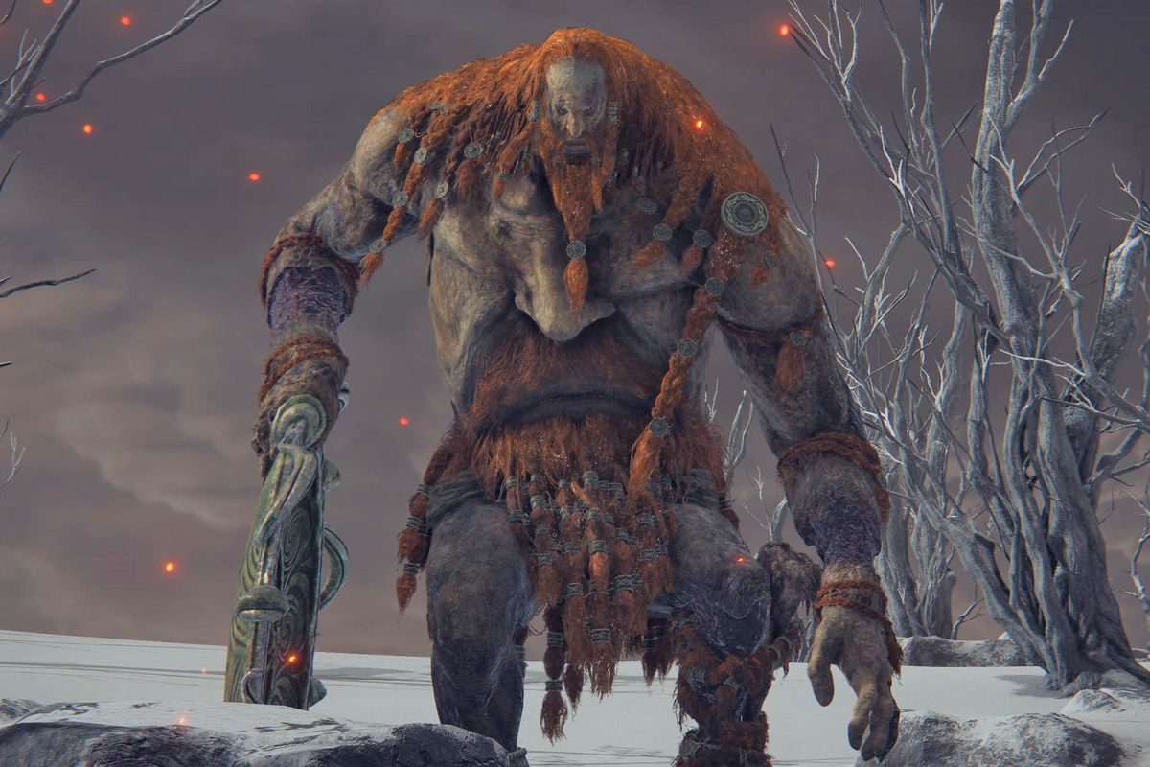
After GPT3
• What's the general figure about GPT3?
🏺: Aowei Ding and Lingfeng Shen

Slide 34
After GPT3
• What's the general figure about GPT3?
A giant model (175B parameters)
Really expensive!! (millions of dollars)
🏺: Aowei Ding and Lingfeng Shen

Slide 35
After GPT3
• What's the general figure about GPT3?
A giant model (175B parameters)
Really expensive!! (millions of dollars)
• What's the advantages of GPT3?
🏺: Aowei Ding and Lingfeng Shen

Slide 36
After GPT3
• What's the general figure about GPT3?
A giant model (175B parameters)
Really expensive!! (millions of dollars)
• What's the advantages of GPT3?
Zero-shot / Few-shot settings
🏺: Aowei Ding and Lingfeng Shen

Slide 37
How to exploit GPT3's potentialities
Fine-tuning? Like we did on previous self-supervised models.
🏺: Aowei Ding and Lingfeng Shen

Slide 38
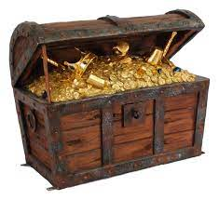
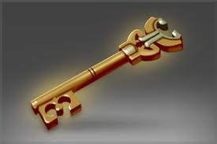
How to exploit GPT3's potentialities
Full data fine-tuning? Like we did on previous self-supervised models.
Treasure Chest (GPT-3)
? ? ?
🏺: Aowei Ding and Lingfeng Shen

Slide 39
How to exploit GPT3's potentialities
Full data fine-tuning? Like we did on previous self-supervised models.
Treasure Chest (GPT-3)
Prompt
🏺: Aowei Ding and Lingfeng Shen

Slide 40
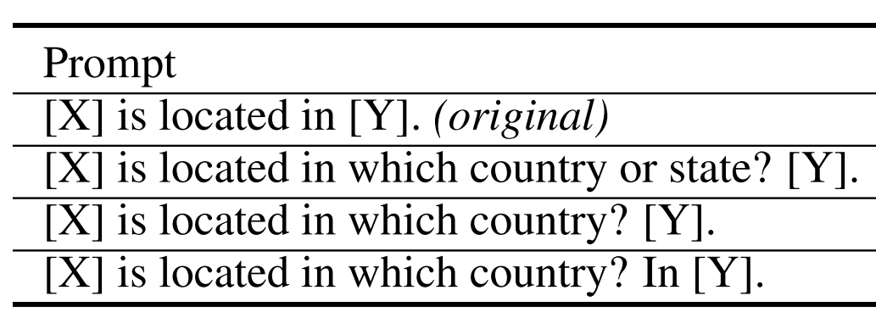
Prompting: Better Ways of Using Large Language Models
Discrete prompts
🏺: Aowei Ding and Lingfeng Shen

Slide 41
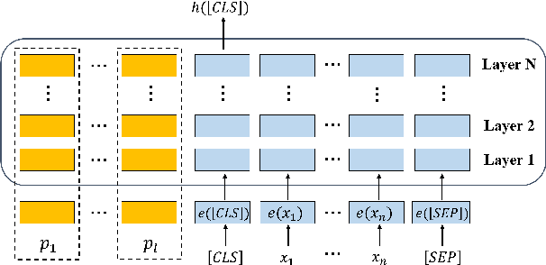
Prompting: Better Ways of Using Large Language Models
Discrete prompts
Continuous prompts
🏺: Aowei Ding and Lingfeng Shen

Slide 42
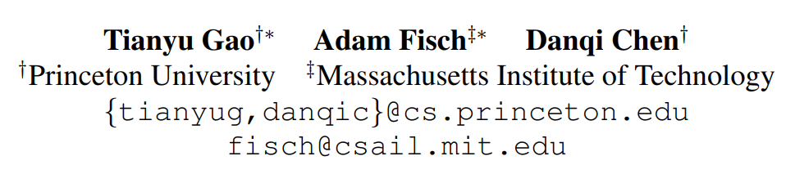
Making Pre-trained Language Models Better Few-shot Learners
🏺: Aowei Ding and Lingfeng Shen

Slide 43
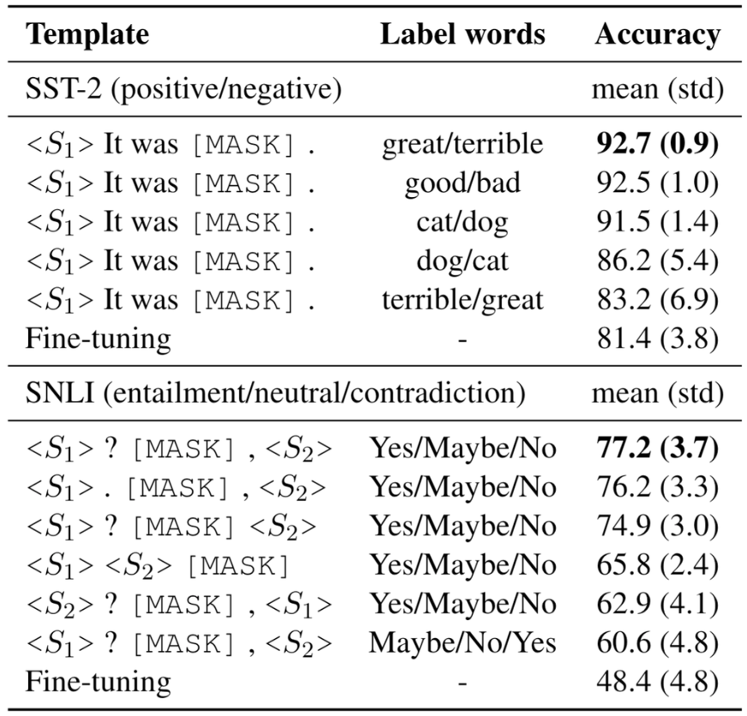
Making Pre-trained Language Models Better Few-shot Learners
hand-crafting good prompts can be tricky
Need domain knowledge
🏺: Aowei Ding and Lingfeng Shen

Slide 44
Making Pre-trained Language Models Better Few-shot Learners
hand-crafting good prompts can be tricky
Need domain knowledge
🏺: Aowei Ding and Lingfeng Shen

Slide 45
Making Pre-trained Language Models Better Few-shot Learners
automatic label word search
top-k words that maximize the LM probability at [MASK]
🏺: Aowei Ding and Lingfeng Shen

Slide 46
Making Pre-trained Language Models Better Few-shot Learners
automatic label word search
top-k words that maximize the LM probability at [MASK]
automatic template search
T5 generation based on manual prompts
🏺: Aowei Ding and Lingfeng Shen

Slide 47
Making Pre-trained Language Models Better Few-shot Learners
automatic label word search
top-k words that maximize the LM probability at [MASK]
automatic template search
T5 generation based on manual prompts
Training objective under few-shot settings
MLM loss to predict the [MASK] in the prompt
🏺: Aowei Ding and Lingfeng Shen

Slide 48
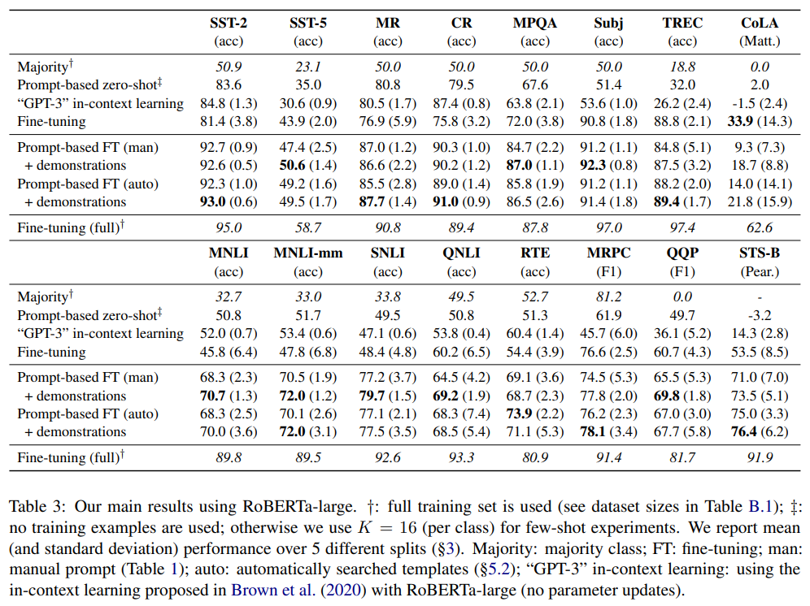
Performance
🏺: Aowei Ding and Lingfeng Shen

Slide 49
Summarization
Bring spotlight
GPT-3
Prompt
Power excavation
🏺: Aowei Ding and Lingfeng Shen

Slide 50
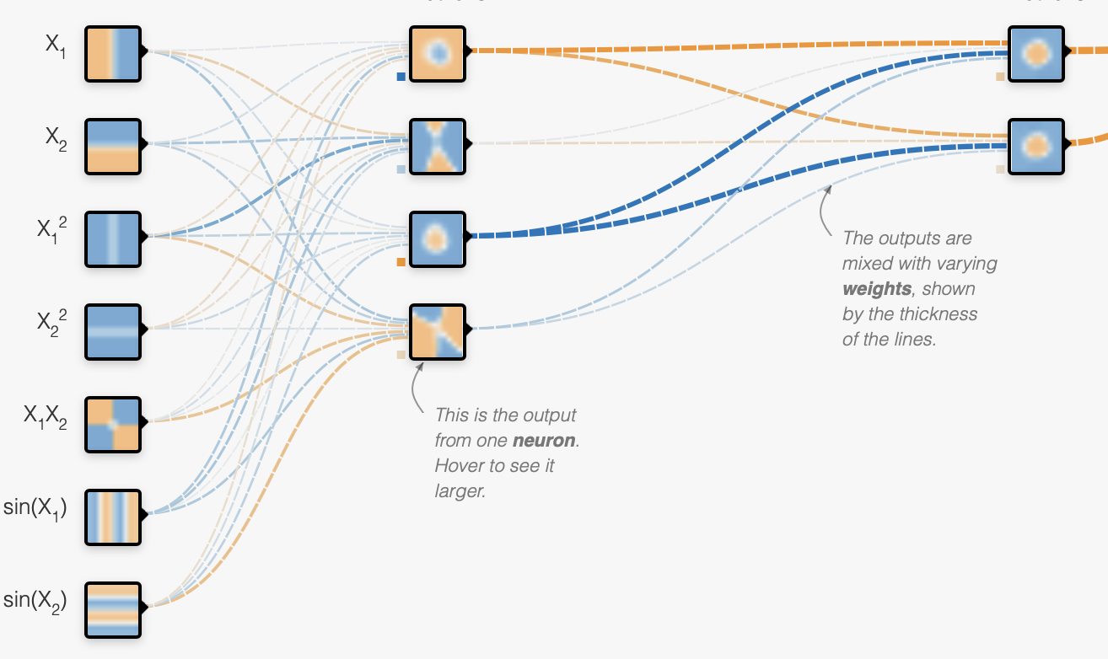
Exploratory Ideas: Memorization vs Structure
Image from https://playground.tensorflow.org/
How much of the training data does the model memorize?
What parts of the network are triggered when there is a memory recall?
Is there some taxonomical structure in the way the network stores information?
🔭: Aayush Mishra and Tianqi Shang

Slide 51
Exploratory Ideas: Memorization vs Structure
Highly overlapping prompts with similar structure → similarity of activation maps. The capital of France is … 2 + 3 is ... The capital of India is … 2 – 3 is ... The currency of France is … 1285673 + 359876 is ...
Distinct prompts with same subjects → dissimilarity of activation maps. The Eiffel Tower is located in … The capital of France is …
Counterfactual prompts → see how to model reacts in the activation space. London is the capital of England. People in London speak … London is the capital of France. People in London speak …
...
🔭: Aayush Mishra and Tianqi Shang

Slide 52
Exploratory Ideas: GPT-3 with Knowledge Graph
An example of a GPT-3 Q&A:
Q: How many eyes does a giraffe have?
A: A giraffe has two eyes.
Q: How many eyes does my foot have?
A: Your foot has two eyes.
Q: How many eyes does a spider have?
A: A spider has eight eyes.
Q: How many eyes does the sun have?
A: The sun has one eye.
fluent answers ✅
common senses❌
knowledge graph💡
🔭: Aayush Mishra and Tianqi Shang

Slide 53
Exploratory Ideas: GPT-3 with Knowledge Graph
Difficulties in Knowledge Graphs development:
1. The cost of building a Knowledge Graph by hand is very high.
e.g., CYC(https://cyc.com/)
2. The accuracy of automatic construction is very low.
e.g., NELL(http://rtw.ml.cmu.edu/rtw/), 10 times error rate
Deep learning models:
GPT-3
Knowledge Graph
Triad: [A, B, C]
Human have hands
🔭: Aayush Mishra and Tianqi Shang

